Slide 1
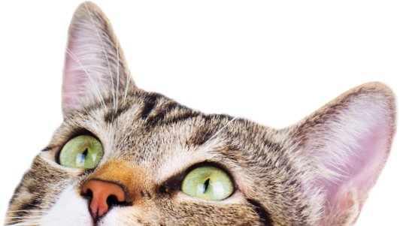
Finding Forever Homes:
Animal Shelter Adoption Predictions
and Non-Kill Shelter Initiatives
Megha Bhande and Agata Świniarska

Slide 2
Animals, Shelters, Adoptions:
What exactly is a non-kill shelter?
Context (United States)
Roughly 6,5 million animals enter shelters each year, only about 3,2 million are adopted.
App. 85 million families are pet owners.
Each year, 920, 000 shelter animals are euthanized.
Over 2,000 individual shelter and rescue organizations are registered and operating within the United States.
Separately, there are 10,000 rescue groups and sanctuaries.
Most shelters strive to reunite, rehabilitate, release and transfer animals in need.
As for 2024, roughly 51% shelters in the US are no-kill shelters. This number went up from 24% in 2016.
OUR GOAL: Explore data released by one of the no-kill shelters to analyze their intake population, predict survivability and adoption rate.
A no-kill shelter is an animal care institution that does not kill healthy or treatable animals based on time limits or capacity. Euthanasia is performed only on terminally ill and dangerous animals that can’t be rehabilitated.
If a shelter kills only up to total 10% animals, it is considered a no-kill shelter.

Slide 3
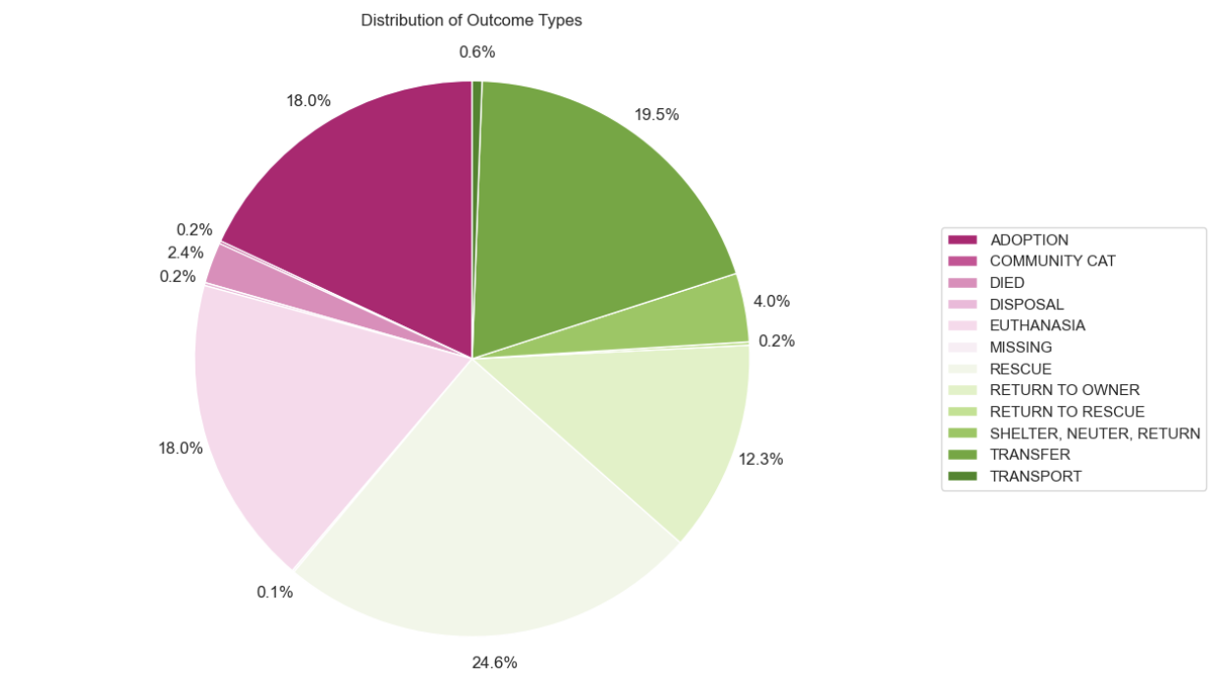
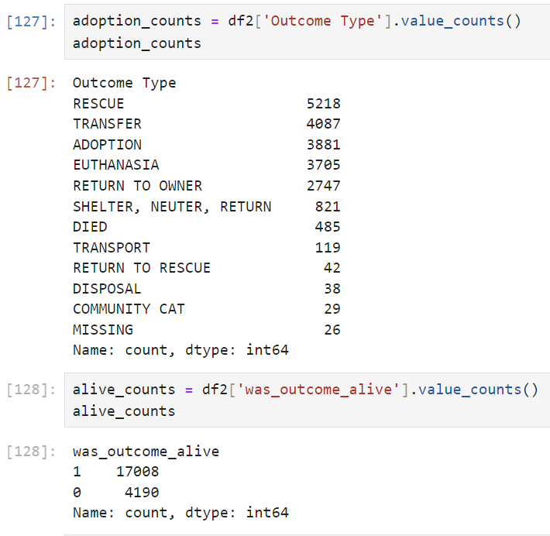
Introduction to Our Analysis : The Dataset and EDA
Overview :
Total number of observations (df2): Rows = 21198 and Columns =19.
Adoption and Alive Animal Counts (Time Range Specific):
Exploratory Data Analysis :
Goal ➤Identify the percentage distribution of outcome type (adoption, euthanasia, transfer etc).

Slide 4
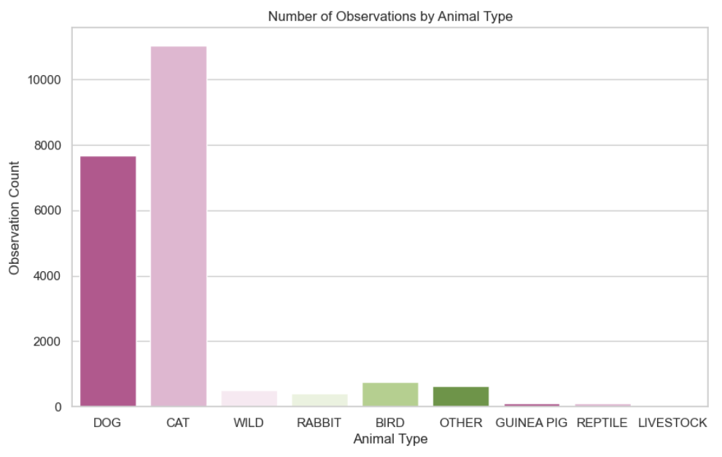
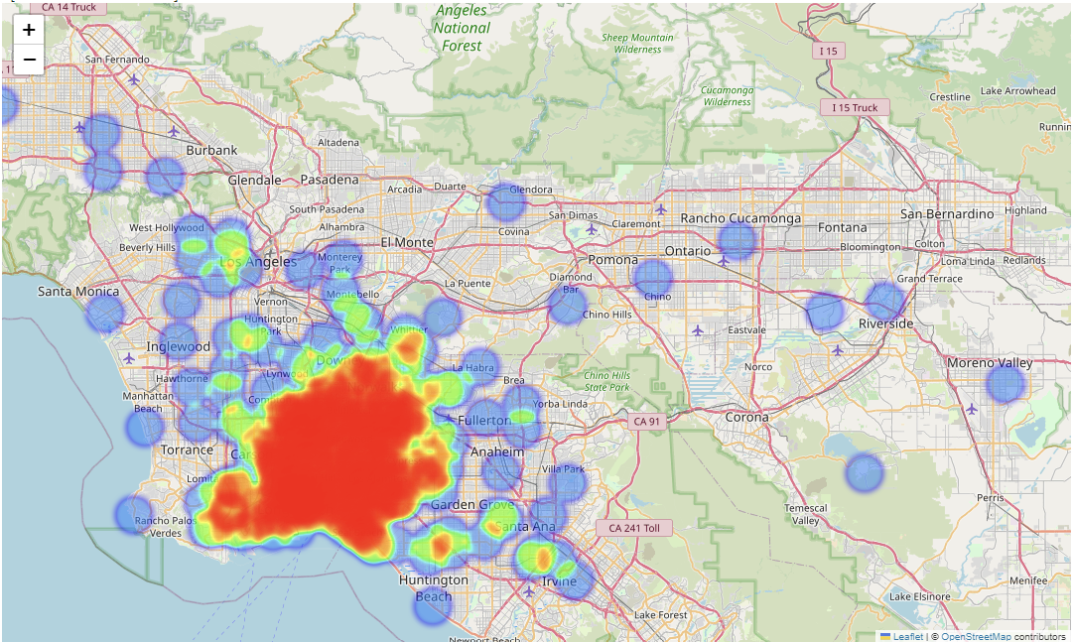
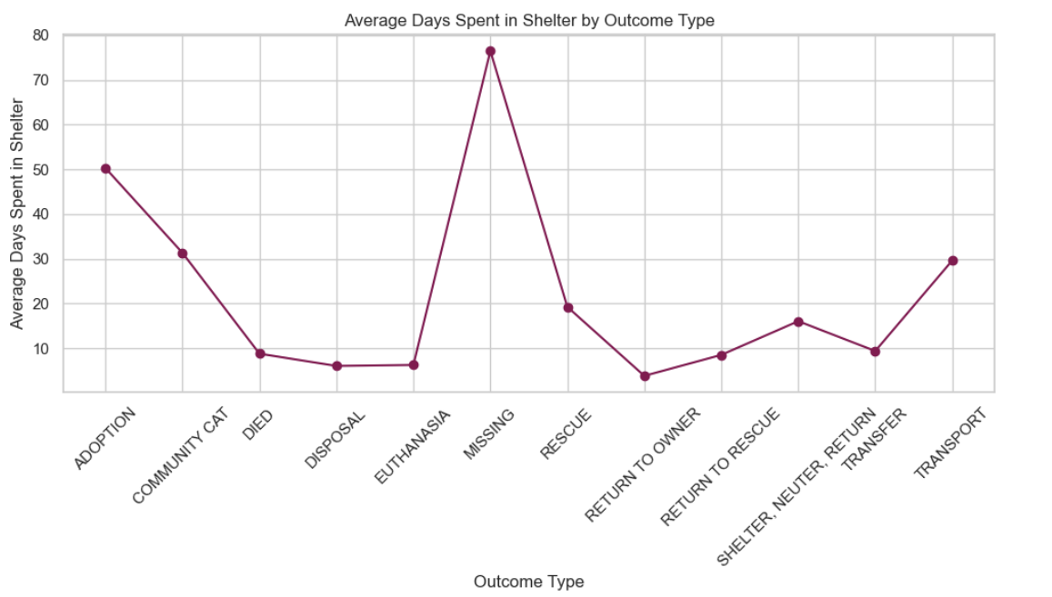
The Data Visualizing Animal Type , Average Shelter Stay by Outcome and Heatmap
Exploring distribution among animal types :
Identifying High-Demand Areas for Animal Services in long beach :
The average number of days spent in the shelter for each outcome type :

Slide 5
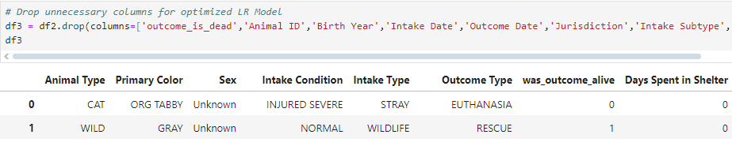

How can we predict an animal’s chances to survive the shelter stay?
Simply - with a Logistic Regression Model!
GOAL ➤ Build a model that predicts the binary target variable was_outcome_alive based on columns: Outcome Type, Sex, Primary Color, Intake Type and Intake Condition and Days Spent in Shelter.
Step 1 - Load our clean categorical dataset and drop unnecessary columns to optimize our LRM.
Step 2 - Use one-hot encoding to get dummies of our soon-to-be dependent variables X.
df3_one_hot_encoded_data = pd.get_dummies(data=df3, columns = ['Animal Type','Outcome Type', 'Sex', 'Primary Color','Intake Type', 'Intake Condition'])
Step 3 - Declare our variables and divide our data into training and testing datasets in ratio 80%-20%.
X = df3_one_hot_encoded_data[feature_vars]
Y = df3_one_hot_encoded_data['was_outcome_alive']
X_train, X_test, Y_train, Y_test = train_test_split(X, Y, test_size=0.2, stratify = Y, random_state=42)
Step 4 - Fit our data, then interpret the intercept and coefficient.
logreg = LogisticRegression()
logreg.fit(X_train, Y_train)
logreg.intercept_ ( the array outputs ([[0.02910983]]))
logreg.coef_ ( the array outputs ([[0.02910983]])

Slide 6
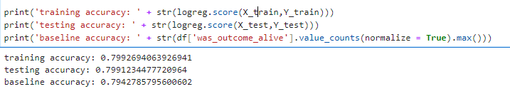



Step 5 - Evaluate the model 1 - training, testing and baseline accuracies.
Step 6 - Create Confusion Matrix
y_true=Y_train
y_pred=logreg.predict(X_train)
pd.DataFrame(confusion_matrix(y_true,y_pred))
Step 7 - Evaluate the model 2 - Precision and Recall
Step 8 - Include Classification Report
print(classification_report(y_true,y_pred))
Step 9 - Use the model to make predictions of variable Y - did the animal survive the shelter stay?
vals_to_predict = pd.DataFrame({'Days Spent in Shelter': [60, 2, 0]})
logreg.predict_proba(vals_to_predict)
logreg.predict(vals_to_predict)
And voila!
Thanks to our model, we can predict with 0.79 % accuracy that three animals who spent 60, 2 and 0 days in the shelter respectively will all live!

Slide 7

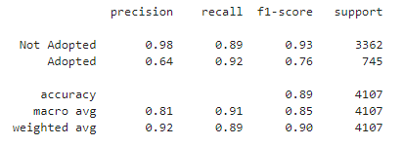

Can we also predict adoption? Let’s try a Decision Tree!
GOAL ➤ Build a DT model that predicts the target variable ADOPTION based on how many days they spent in shelter.
Step 1 - Get dummies of Outcome Type column from our clean dataset
df_new_encoded = pd.get_dummies(df3)
Step 2 - Separate feature and target variables
X = df_new_encoded.drop(columns=['Outcome Type_ADOPTION'], axis=1)
Y = df_new_encoded['Outcome Type_ADOPTION']
Step 3 - split our model into training and testing sets
X_train, X_test, Y_train, Y_test = train_test_split(X, Y, stratify=Y, train_size=0.2, random_state=42)
Step 4 - Instantiate and train a DecisionTreeClassifier with entropy as a criterion
dec_tree = DecisionTreeClassifier(criterion='entropy', max_depth=3, random_state=42)
dec_tree.fit(X_train, Y_train)
Step 5 - Define our class names
class_names = ['Not Adopted', 'Adopted']
Step 5 - Plot the tree!
Step 6 - Fit, evaluate and use it to make predictions similarly to LRM.
Step 7 - Print out classification report.

Slide 8
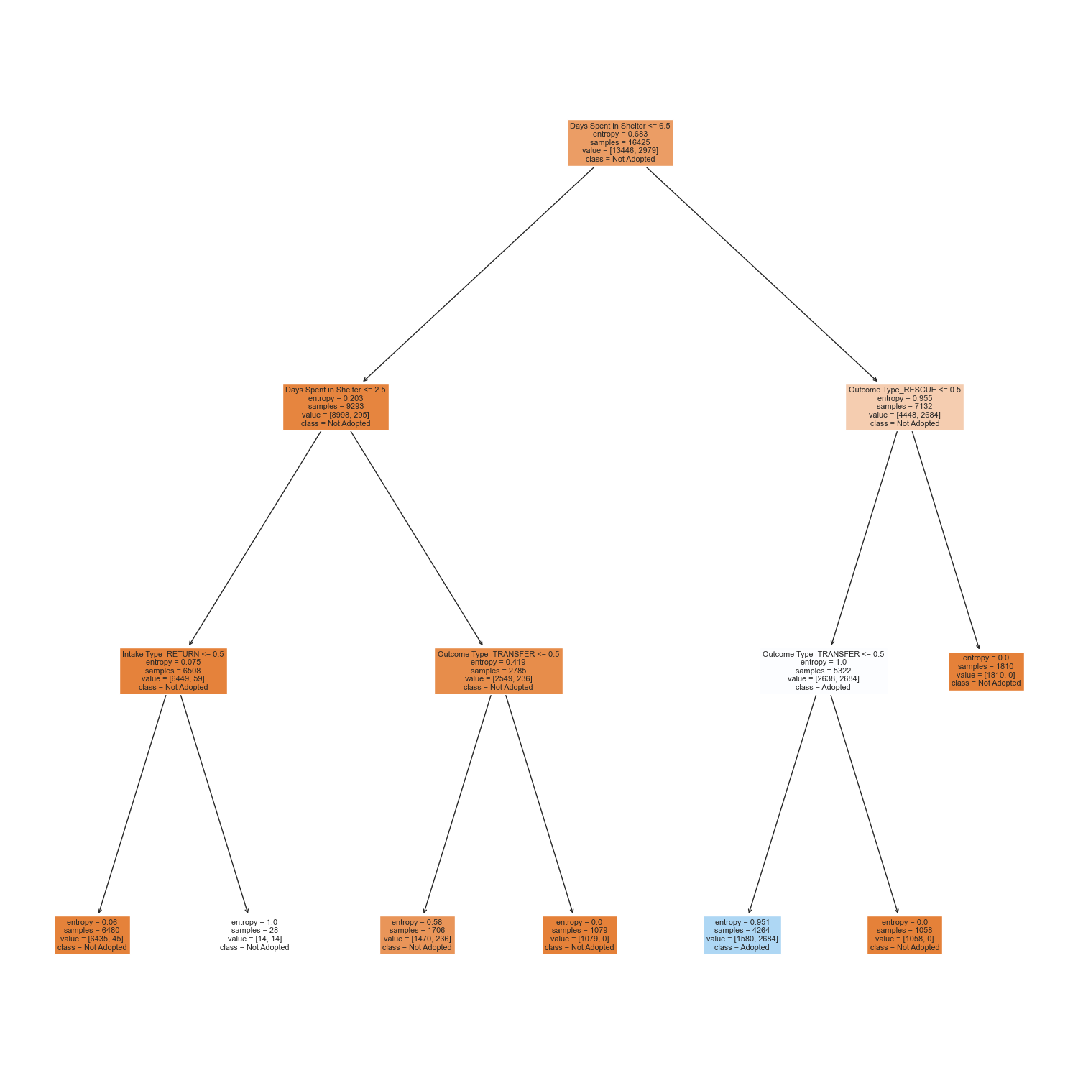
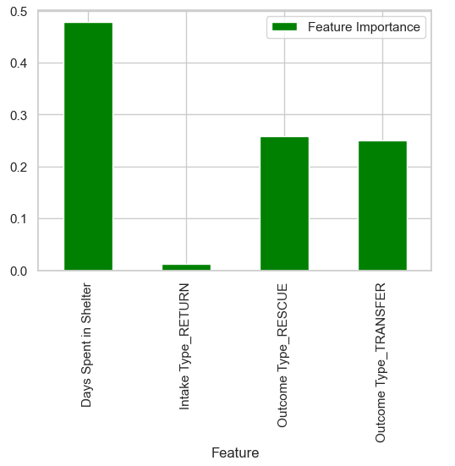
Bonus: Feature Importance
feature_importances = pd.DataFrame({'Feature': X.columns, 'Feature Importance': dec_tree.feature_importances_})
non_zero_importance_features = feature_importances[feature_importances['Feature Importance'] != 0]
display(non_zero_importance_features)

Slide 9
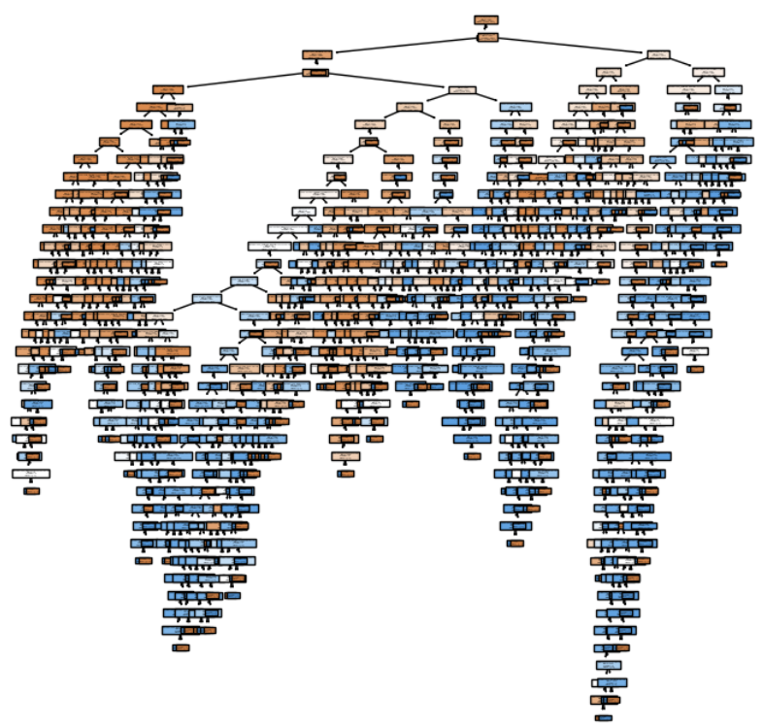
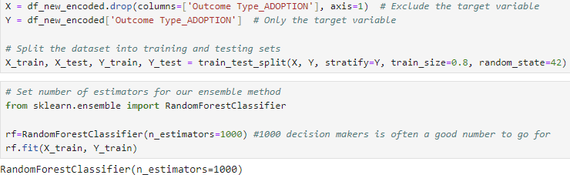
How can we be even more sure: Random Forest
GOAL ➤ Build a Random Forest model with 1000 estimators that predicts the chances for adoption in Long Beach Shelter. Our target variable Outcome Type_ADOPTION is based on columns: Days Spent in Shelter,Outcome Type_RESCUE, Intake Type_RETURN and Outcome Type TRANSFER.
View the random estimator tree
Here we Build the Random Forest Model.
Separate features and target variable.
Evaluate our Random Forest Model
Train score : 1.0
Test score : 0.9968346725
Calculate Baseline accuracy
Baseline accuracy: 81.86301369863014
Plot the random estimator tree

Slide 10
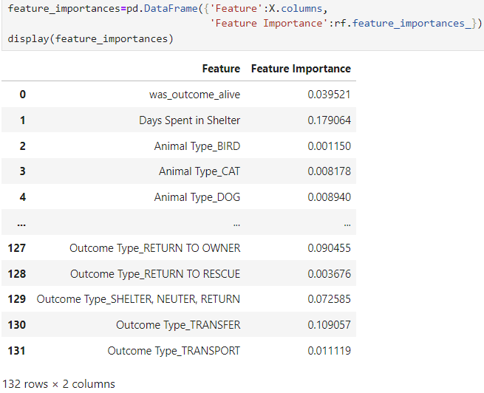
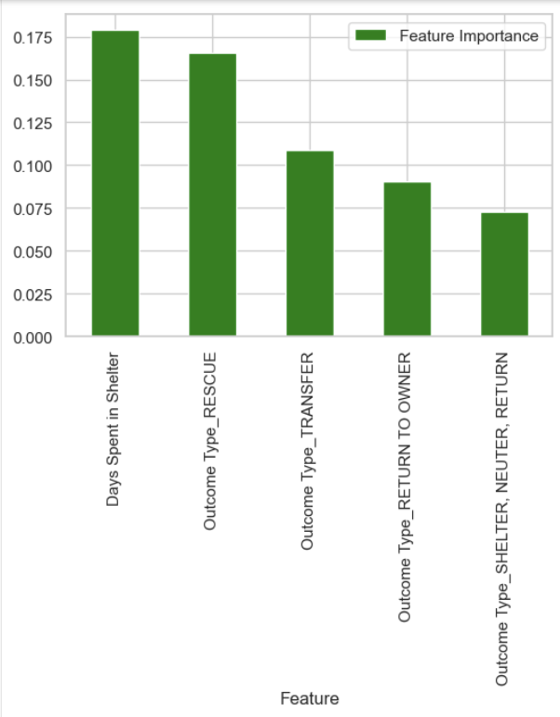
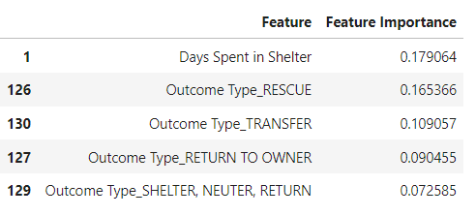
The Importance of a feature of our Random Forest Model
Calculate the feature importance for Random Forest
Display top 5 important features for our Random Forest Model
Display the top 5 most important features

Slide 11

In Conclusion
Long Beach Shelter, as a no-kill shelter has a [~18%] adoption rate and [~80% ] survivability rate as for 2024.
No-kill shelter status could hypothetically boost survivability and adoption rates for animals. It’s important to advocate for no-kill shelters , but also support traditional shelters in their transition.
Most animals that come into shelters are dogs and cats, and their fate can be decided by a number of factors (age, color, days spent in shelter, area which they came from).

Slide 12
Thank you for your attention.
References:
Our dataset: Long Beach City Animal Shelter Data
https://www.onevet.ai/animal-shelter-statistics/
https://www.thezebra.com/resources/research/pet-adoption-statistics/
https://www.aspca.org/helping-people-pets/shelter-intake-and-surrender/pet-statistics
https://spots.com/animal-shelter-statistics/
For more information on animal welfare, volunteering and shelters in Spain visit:
FAADA - https://faada.org/entidades-asociaciones-protectoras
El REFUGIO - https://elrefugio.org/home
MIWUKI PET SHELTER - https://petshelter.miwuki.com/protectoras-y-asociaciones-de-animales-de-espana

